Slide 1

Summative Assessment: Individual Presentation
Assignment Topic: Neural Network Models for Object Recognition
Module: Machine Learning

Slide 2
Index
Introduction
EDA
Pre-Processing
Data partitioning
Architecture
Training
Evaluation
Improvements
Conclusion
References

Slide 3
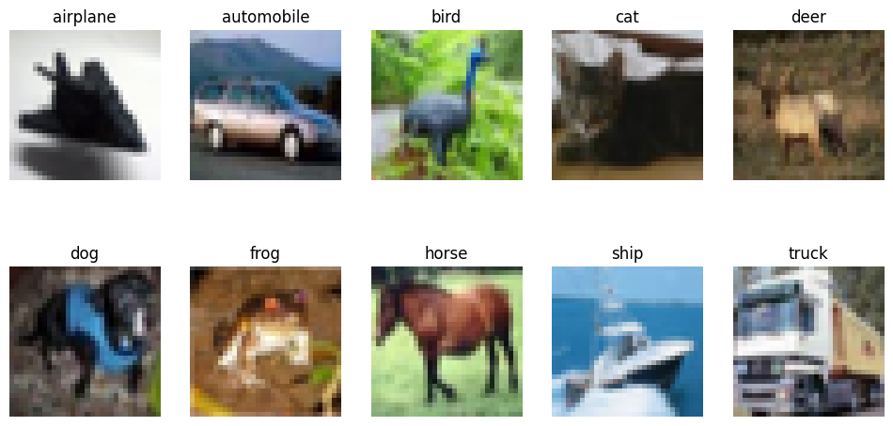
Introduction
Build an Artificial Neural Network (ANN) using the CIFAR-10 dataset
Evaluate the network performance.
Develop a model with sufficient high-performance
Capable to classify correctly, each image according to their respective category

Slide 4
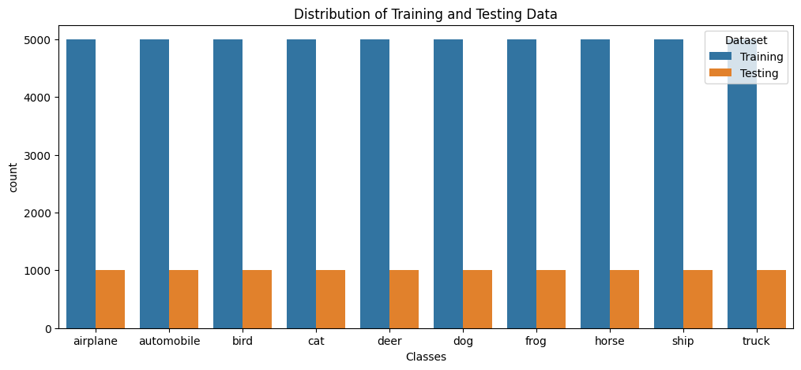
EDA
CIFAR-10 image dataset
Contains 60,000 32x32 color images
3 RGB values that range from 0 to 255
10 classes: airplane, bird, cat...
Data is well distributed and balanced

Slide 5
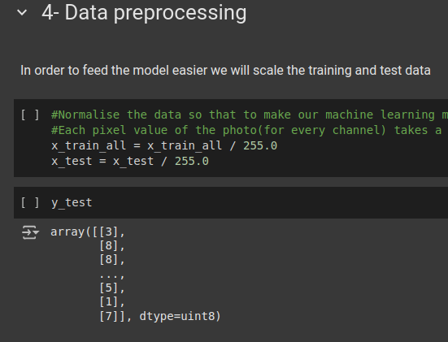
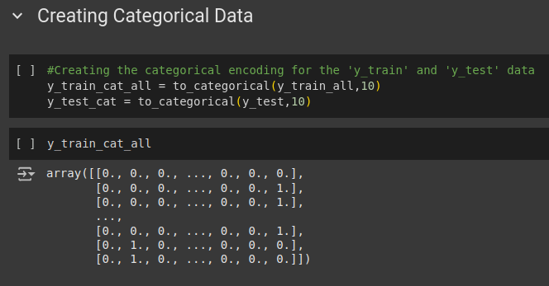
Preprocessing
Ensuring the input data is properly optimised and formatted (Nazri, M., 2013)
Data is normalised
Converted to categorical data with a range of 0-255, into 0-1.
Data distribution becomes more standard

Slide 6
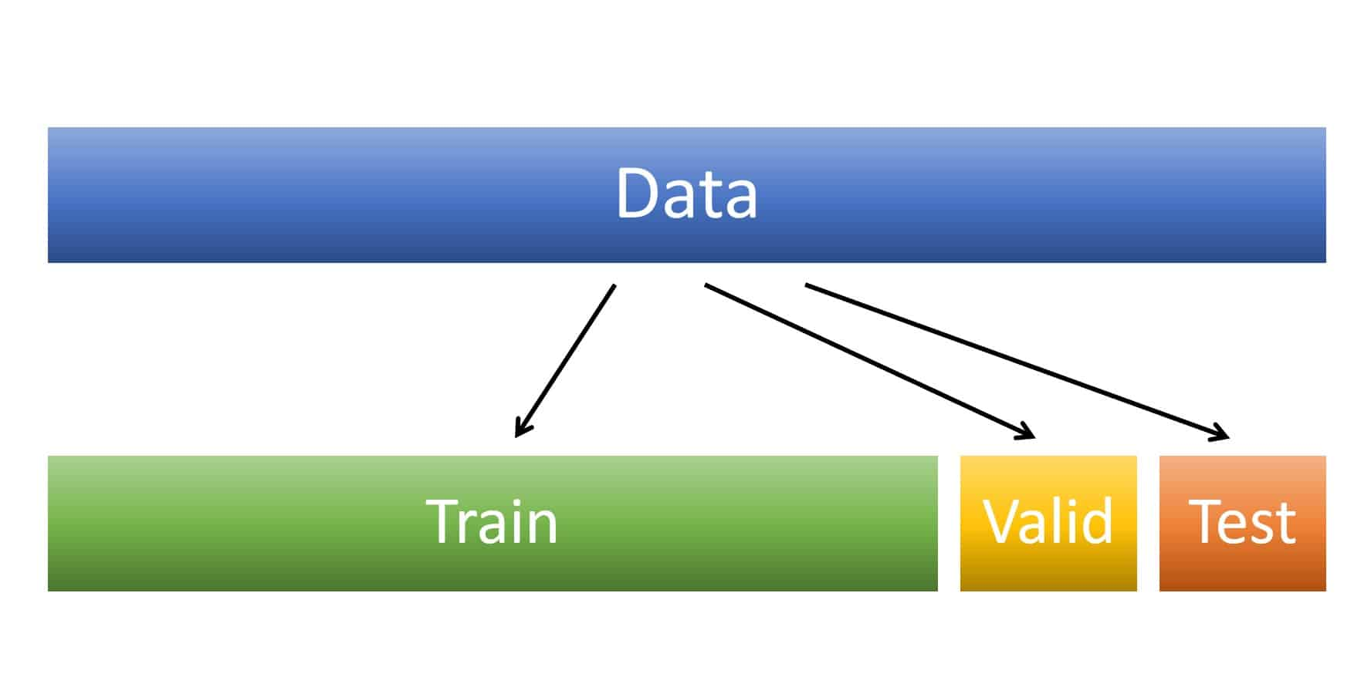
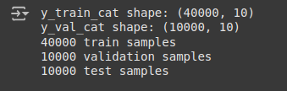
Data partitions
Helps with assessing the model performance on unseen data(Patil, S., 2020)
Validation split allows hyperparameters optimization before testing
Training Set: 40,000 images.
Validation Set: 10,000 images.
Test Set: 10,000 images.

Slide 7
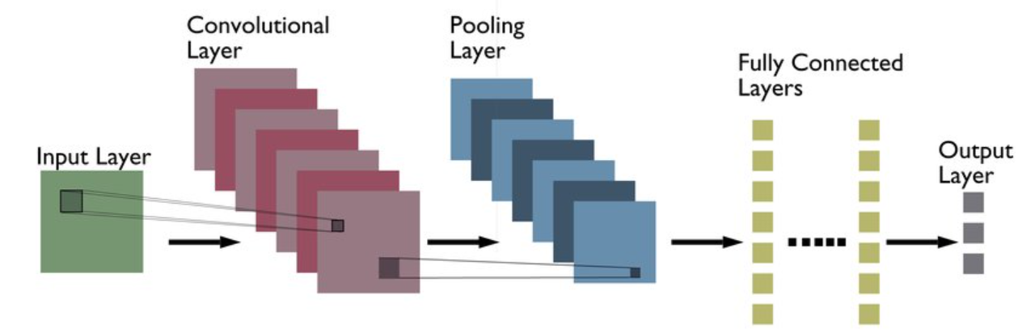
Architecture
Convolutional Neural Network model
VGG architecture
Input Layer
Convolutional Layer
Activation Function: RELU
Pooling Layer
Activation Function: SoftMax
Output Layer

Slide 8
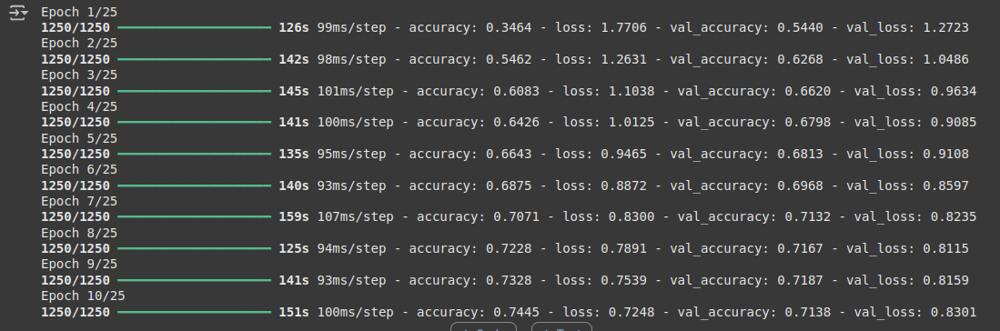
Training
Strategy: Adjust weights based on training data
Loss function: categorical_crossentropy
Epochs: 25
Early stopping: validation loss the same over two iterations.

Slide 9
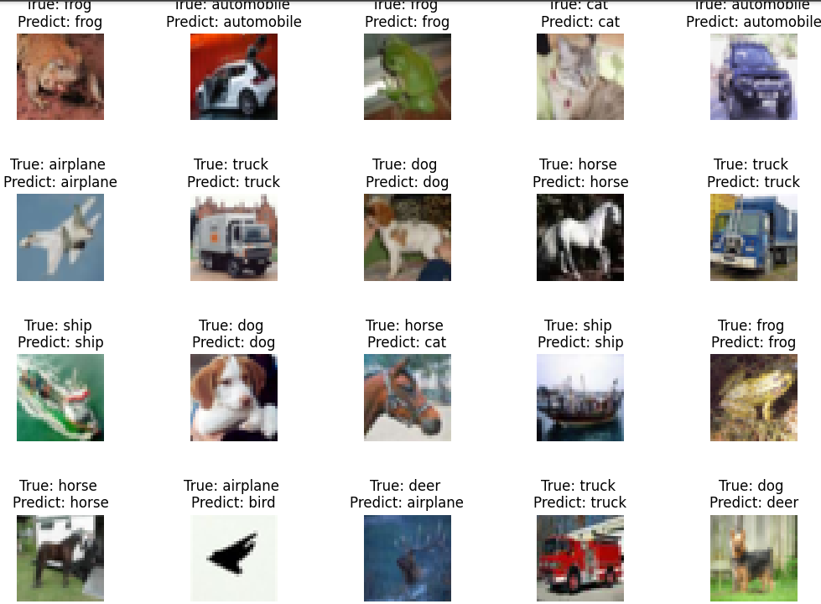
Evaluation
Training accuracy: ~74%
Training Loss: 0.7248
Validation Accuracy: ~71%
Validation loss: 0.8301
Test accuracy: ~ 72%
Test loss: 0.8284

Slide 10
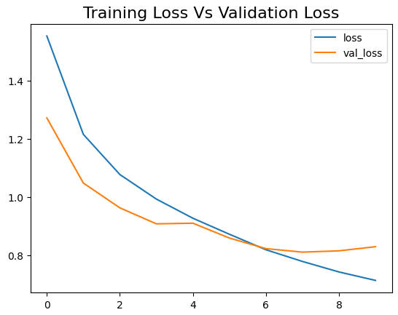
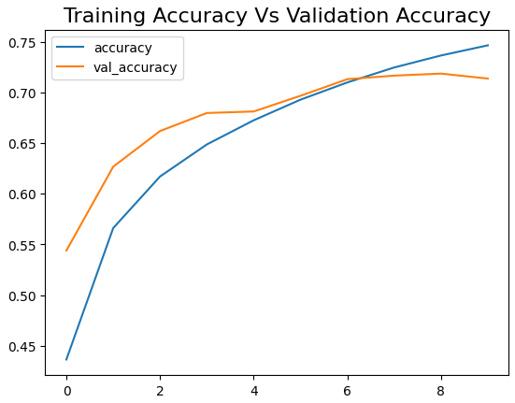

Slide 11
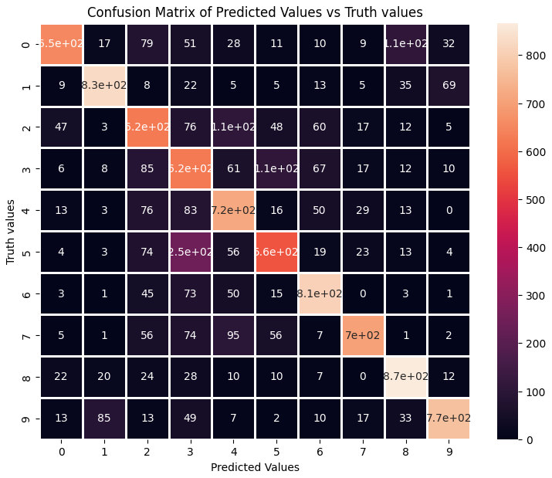
Confusion matrix

Slide 12
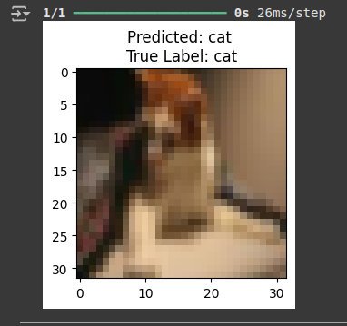
Single Image test

Slide 13
Strengths & Weaknesses
Strengths:
Encouraging results after the first training
Validation accuracy decreases steadily which shows the model is avoiding overfitting
Weaknesses:
Can be confused by images with similar features such as bird, airplane
Accuracy is still low to be deployed to real world environments.

Slide 14
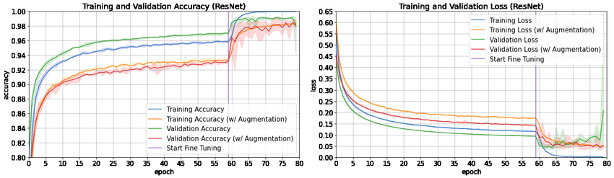
Improvements
Data augmentation. (Alhassan Mumuni et al 2022)
Leaky-RELU & ELU combination(Ritesh Maurya et al. 2023)
Transfer learning with pre-trained models (e.g., ResNet).
Hyperparameter optimization
Explore different datasets such as ImageNet.

Slide 15
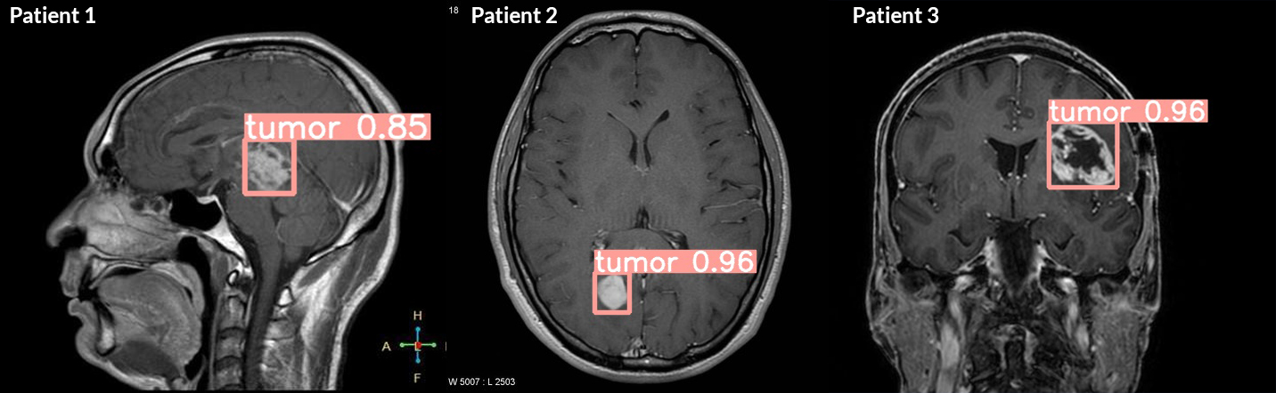
Conclusion
A powerful tool for the future in various fields such as healthcare. (Thomas Davenport, et al 2019)
Building the model helped understand the fundamentals of image classification.
Knowledge acquired to how ANNs perform on real-life data.
More appreciation of how complex the human mind is.

Slide 16

Thank you for watching.

Slide 17
References
Wang, X., Han, X., & Zhang, H. (2020) Face image recognition based on convolutional neural network. IEEE 17(2): 117-124. DOI: https://ieeexplore.ieee.org/abstract/document/9020302 [Accessed 3 January 2025].
Patil, S., Nagaraja, G. (2020). Exploratory Data Analysis. International Research Journal of Engineering and Technology (IRJET) 7(05). DOI: https://www.academia.edu/download/64615158/IRJET-V7I51256.pdf [Accessed 5 January 2025].
Tohidul, M. & Nafix, K. (2018). Image Recognition with Deep Learning. IEEE 22(5). DOI: https://ieeexplore.ieee.org/abstract/document/8550021 [Accessed 6 January 2025].
Kaggle (2008). CIFAR-10 Object Recognition in Images. Available via: https://www.kaggle.com/competitions/cifar-10/overview [Accessed 6January 2025].
Keiron, O., Nash, R. (2015). An Introduction to Convolutional Neural Networks. Available via: https://arxiv.org/pdf/1511.08458 [Accessed 7 January 2025].
Mumuni, A., & Fuseini, M. (2022). Data augmentation: A comprehensive survey of modern approaches. AI Journal 16(1). DOI: https://www.sciencedirect.com/science/article/pii/S2590005622000911 [Accessed 8 January 2025].

Slide 18
References
Maurya, R., Aggarwal, D., & Gopalakrishnan, T. (2023) . FEnhancing Deep Neural Network Convergence and Performance: A Hybrid Activation Function Approach by Combining ReLU and ELU Activation Function. 2023 Second International Conference on Informatics (ICI) 17(2): 1-5. DOI: https://ieeexplore.ieee.org/abstract/document/9020302 [Accessed 9 January 2025].
Kaggle (2022). ResNet50 Datasets. Available via: https://www.kaggle.com/datasets/crawford/resnet50 [Accessed 10 January 2025].
Davenport. T., & Kalakota, R. (2019). The potential for artificial intelligence in healthcare. Future Healthcare Journal 6(2): 94-98. DOI: https://www.sciencedirect.com/science/article/pii/S2514664524010592 [Accessed 11 January 2025].
Goriparthi, R. (2024). Deep Learning Architectures for Real-Time Image Recognition: Innovations and Applications. REVISTA DE INTELIGENCIA ARTIFICIAL EN MEDICINA 15(1): 1-28. DOI: http://redcrevistas.com/index.php/Revista/article/view/219/236 [Accessed 13 January 2025].
Nazri, M., & Atomi, W. (2014). The Effect of Data Pre-processing on Optimized Training of Artificial Neural Networks. Procedia Technology 11(1): 32-39. DOI: https://www.sciencedirect.com/science/article/pii/S2212017313003137 [Accessed 19 January 2025].
Franke, M., & Degen, J. (2023). The softmax function: Properties, motivation, and interpretation. AI Journal 5(2): 23-29. DOI: https://osf.io/preprints/psyarxiv/vsw47 [Accessed 19 January 2025].

